Slide 1

QR Code Generator
Shu xu, Yukun zhou

Slide 2
Introduction to QR code
invented by? when? for what?
how to store information? bar code?
how are they used in today’s economy?

Slide 3
Project Introduction
QR code specification
what kind of work should be done?

Slide 4
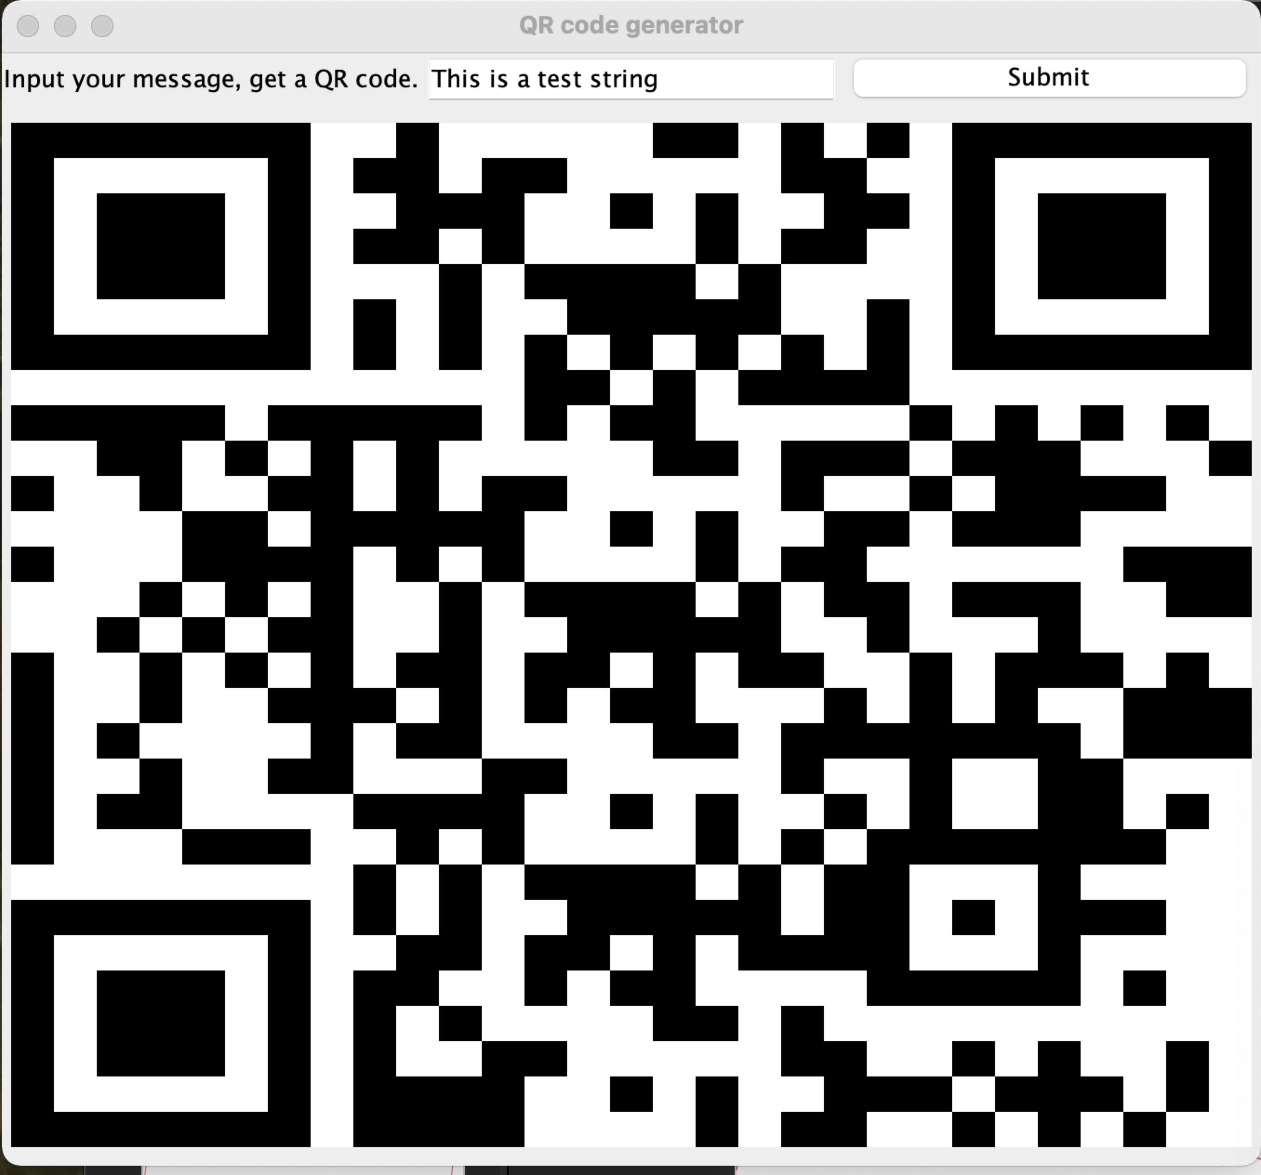





Design
controller
Basic Idea: Java for encoding and GUI for image presentation
Design Pattern: MVC++
uml
model

Slide 5

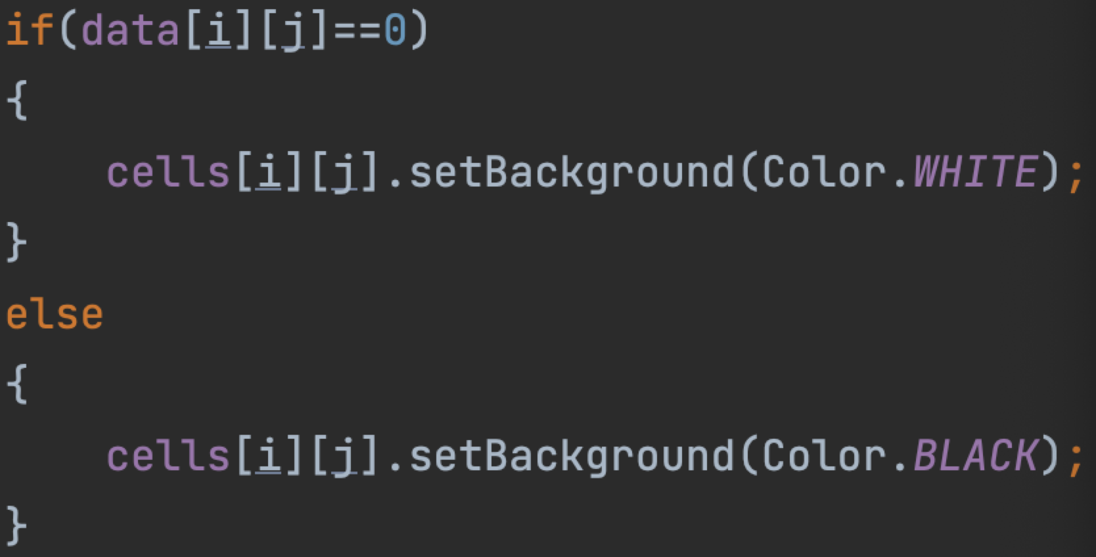




Code Walk 2 - details
29 * 29 2-D binary int array (Data class)
1 -> black 0 -> white (Image class)
(pixels in a grid layout)
Classes:
Data (ByteMode, Evaluation, Mask, logAntiLog)
Image (ImageDemo)
int[][]
Data Image
String

Slide 6
Code Walk 3 - implementation
Data: from “This is a test string” to int[29][29]
Image: 1. receive “This is a test string”
2. from int[29][29] to the QR code

Slide 7


Code Walk 4 - Image
InfoArea: 1*3 GridLayout JPanel
infoLabel infoInput submit
imageContainer: 29*29 GridLayout JPanel
for(int i=0; i<29; i++)
for(int j=0; j<29; j++)
cells[i][j] = new Jpanel();
cells[i][j] <-> data[i][j]
imageContainer.add(cell)

Slide 8






Code Walk 5 - Data
Fixed part:
Encoding part: tons of helper methods
public static int[][] generateData(String data)
returns the final-final-final result

Slide 9
Demo

Slide 10
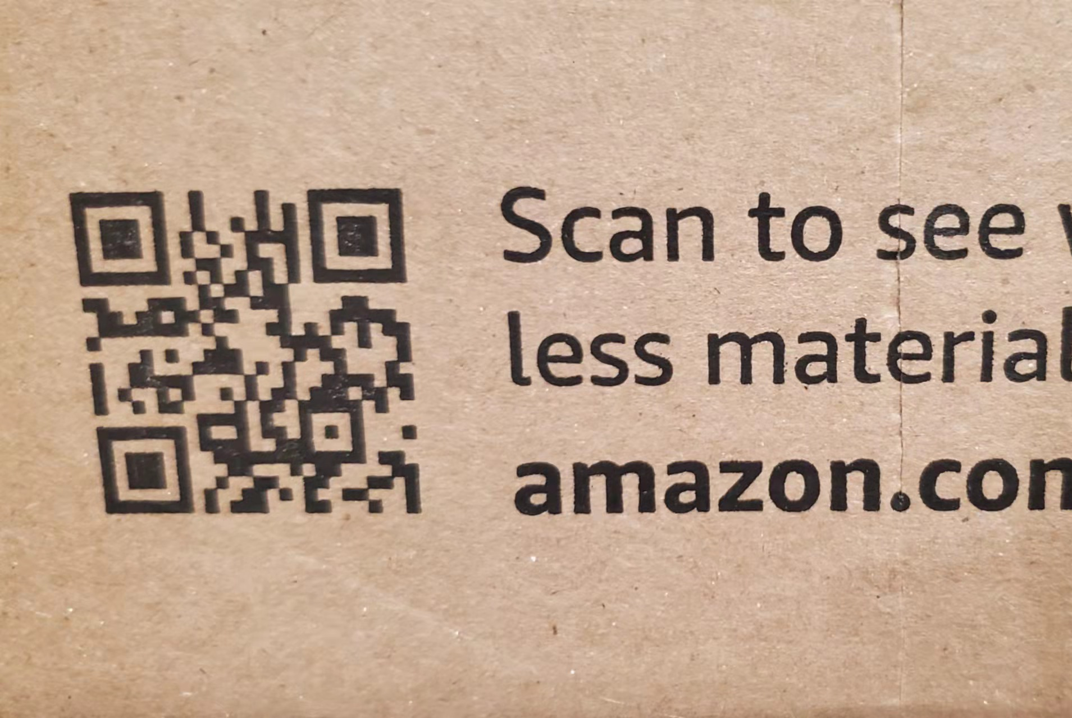
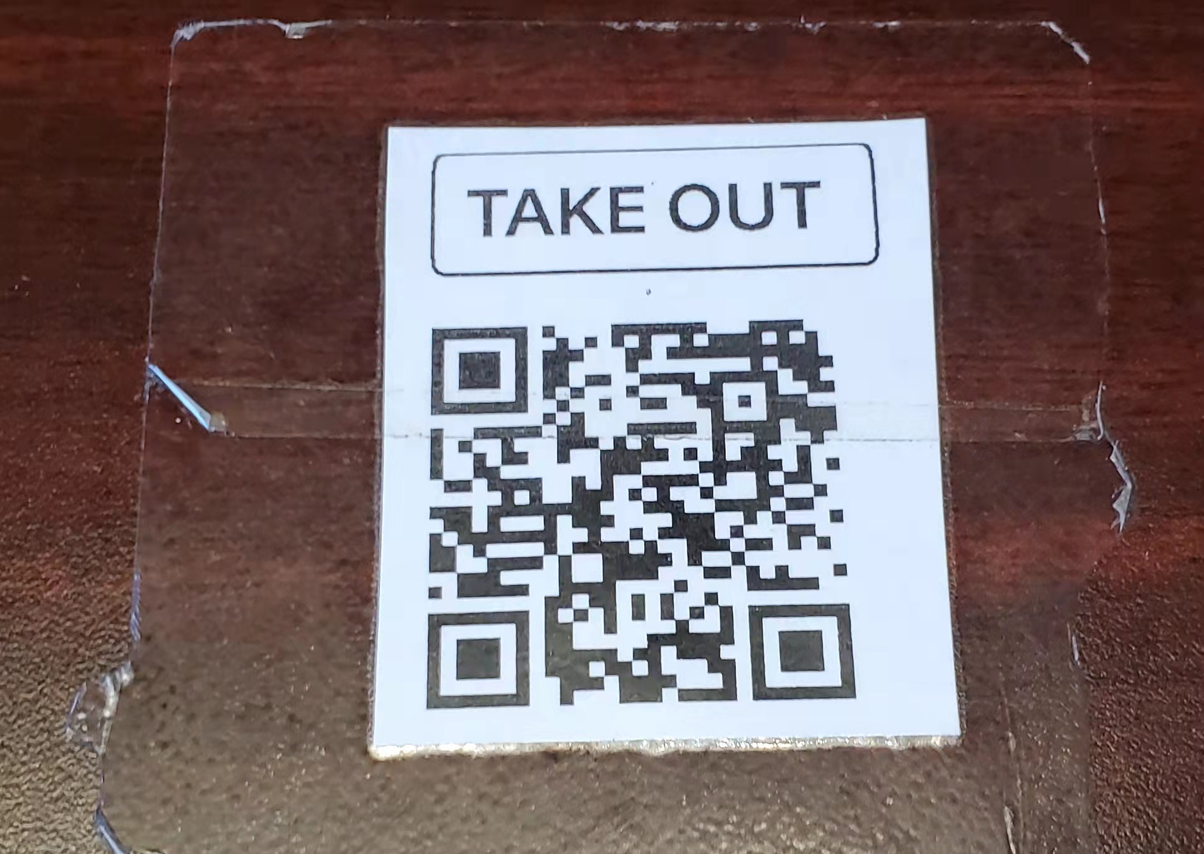
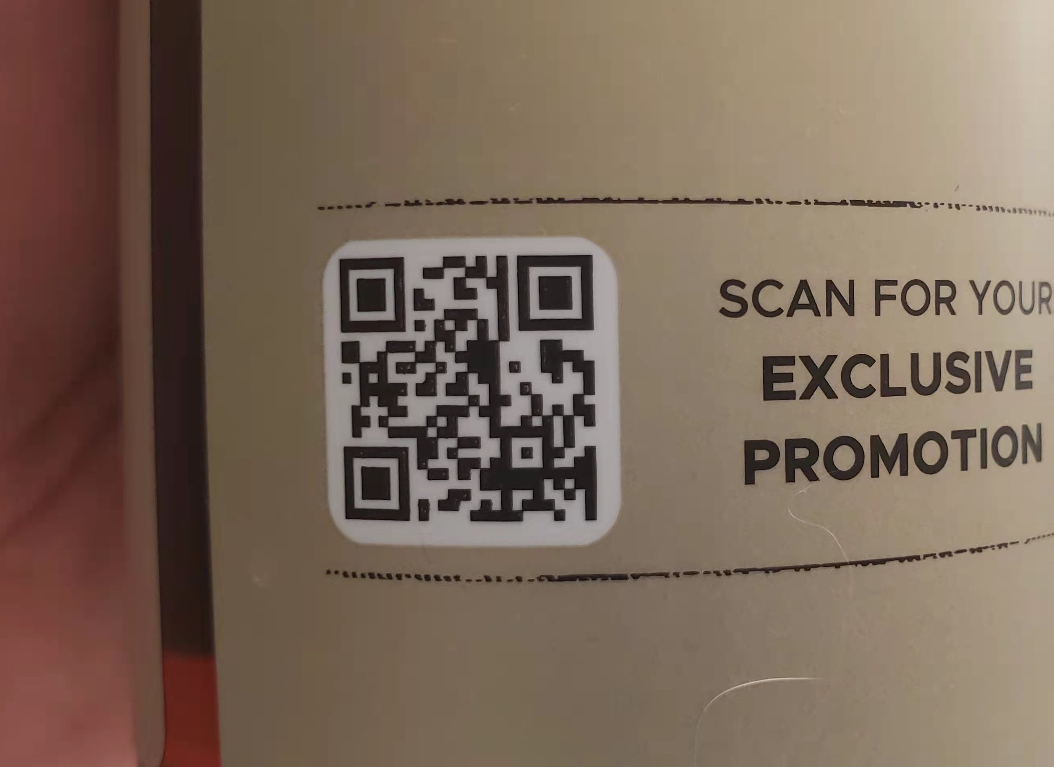
Extension/Application
As introduced, QR code already widely used
http://amazon.com/thisboxusqr
https://www.39miles.com/p/14203179
www.39miles.com(company) (web dev)
http://qr.hb-free.com(404)

